Slide 1
Chapter 01: Set Theory
DISCRETE MATHS
Higher Nationals in Computing
BCAS Campus, Kalmunai

Slide 2
What is a set?
A set is a group of “objects”
  People in a class: { Alice, Bob, Chris }
  Classes offered by a department: { CS 101, CS 202, … }
  Colors of a rainbow: { red, orange, yellow, green, blue, indigo, purple }
  States of matter { solid, liquid, gas, plasma }
  States in the US: { Alabama, Alaska, Virginia, … }
  Sets can contain non-related elements: { 3, a, red, Virginia }
Although a set can contain (almost) anything, we will most often use sets of numbers
  All positive numbers less than or equal to 5: {1, 2, 3, 4, 5}
  A few selected real numbers: { 2.1, π, 0, -6.32, e }

Slide 3
Set properties 1
Order does not matter
  We often write them in order because it is easier for humans to understand it that way
  {1, 2, 3, 4, 5} is equivalent to {3, 5, 2, 4, 1}
Sets are notated with curly brackets

Slide 4
Set properties 2
Sets do not have duplicate elements
  Consider the set of vowels in the alphabet.
    It makes no sense to list them as {a, a, a, e, i, o, o, o, o, o, u}
    What we really want is just {a, e, i, o, u}
  Consider the list of students in this class
    Again, it does not make sense to list somebody twice
Note that a list is like a set, but order does matter and duplicate elements are allowed
  We won’t be studying lists much in this class

Slide 5
Specifying a set 1
Sets are usually represented by a capital letter (A, B, S, etc.)
Elements are usually represented by an italic lower-case letter (a, x, y, etc.)
Easiest way to specify a set is to list all the elements: A = {1, 2, 3, 4, 5}
  Not always feasible for large or infinite sets

Slide 6
Specifying a set 2
Can use an ellipsis (…): B = {0, 1, 2, 3, …}
  Can cause confusion. Consider the set C = {3, 5, 7, …}. What comes next?
  If the set is all odd integers greater than 2, it is 9
  If the set is all prime numbers greater than 2, it is 11
Can use set-builder notation
  D = {x | x is prime and x > 2} = {3, 5, 7, 11, 13,…….}
  E = {x | x is odd and x > 2} = {3, 5, 7, 9, 11,…….}
  The vertical bar means “such that”
  Thus, set D is read (in English) as: “all elements x such that x is prime and x is greater than 2”

Slide 7
Specifying a set 3
A set is said to “contain” the various “members” or “elements” that make up the set
  If an element a is a member of (or an element of) a set S, we use then notation a ∈ S
    4 ∈ {1, 2, 3, 4}
  If an element is not a member of (or an element of) a set S, we use the notation a ∉ S
    7 ∉ {1, 2, 3, 4}
    Virginia ∉ {1, 2, 3, 4}

Slide 8
Often used sets
N = {0, 1, 2, 3, …} is the set of natural numbers
Z = {…, -2, -1, 0, 1, 2, …} is the set of integers
Z⁺ = {1, 2, 3, …} is the set of positive integers (a.k.a whole numbers)
  Note that people disagree on the exact definitions of whole numbers and natural numbers
Q = {p/q | p ∈ Z, q ∈ Z, q ≠ 0} is the set of rational numbers
  Any number that can be expressed as a fraction of two integers (where the bottom one is not zero)
R is the set of real numbers

Slide 9
The universal set 1
U is the universal set – the set of all of elements (or the “universe”) from which given any set is drawn
  For the set {-2, 0.4, 2}, U would be the real numbers
  For the set {0, 1, 2}, U could be the natural numbers (zero and up), the integers, the rational numbers, or the real numbers, depending on the context

Slide 10
The universal set 2
  For the set of the students in this class, U would be all the students in the University (or perhaps all the people in the world)
  For the set of the vowels of the alphabet, U would be all the letters of the alphabet
  To differentiate U from U (which is a set operation), the universal set is written in a different font (and in bold and italics)

Slide 11
Venn diagrams
Represents sets graphically
  The box represents the universal set
  Circles represent the set(s)
Consider set S, which is
the set of all vowels in the
alphabet
The individual elements
are usually not written
in a Venn diagram
b
c
d
f
U
g
h
j
S
k
l
m
n
p
q
a
e
i
r
s
t
o
u
v
w
x
y
z

Slide 12
Sets of sets
Sets can contain other sets
  S = { {1}, {2}, {3} }
  T = { {1}, {{2}}, {{{3}}} }
  V = { {{1}, {{2}}}, {{{3}}}, { {1}, {{2}}, {{{3}}} } }
    V has only 3 elements!
Note that 1 ≠ {1} ≠ {{1}} ≠ {{{1}}}
  They are all different

Slide 13
The empty set 1
If a set has zero elements, it is called the empty (or null) set
  Written using the symbol ∅
  Thus, ∅ = { } ← VERY IMPORTANT
  If you get confused about the empty set in a problem, try replacing ∅ by { }
As the empty set is a set, it can be an element of other sets
  { ∅, 1, 2, 3, x } is a valid set

Slide 14
The empty set 1
Note that ∅ ≠ { ∅ }
  The first is a set of zero elements
  The second is a set of 1 element (that one element being the empty set)
Replace ∅ by { }, and you get: { } ≠ { { } }
    It’s easier to see that they are not equal that way

Slide 15
Set equality
Two sets are equal if they have the same elements
  {1, 2, 3, 4, 5} = {5, 4, 3, 2, 1}
    Remember that order does not matter!
  {1, 2, 3, 2, 4, 3, 2, 1} = {4, 3, 2, 1}
    Remember that duplicate elements do not matter!
Two sets are not equal if they do not have the same elements
  {1, 2, 3, 4, 5} ≠ {1, 2, 3, 4}

Slide 16
Subsets 1
If all the elements of a set S are also elements of a set T, then S is a subset of T
  For example, if S = {2, 4, 6} and T = {1, 2, 3, 4, 5, 6, 7}, then S is a subset of T
  This is specified by S ⊆ T
    Or by {2, 4, 6} ⊆ {1, 2, 3, 4, 5, 6, 7}
If S is not a subset of T, it is written as such:
S ⊆ T
  For example, {1, 2, 8} ⊆ {1, 2, 3, 4, 5, 6, 7}

Slide 17
Subsets 2
Note that any set is a subset of itself!
  Given set S = {2, 4, 6}, since all the elements of S are elements of S, S is a subset of itself
  This is kind of like saying 5 is less than or equal to 5
  Thus, for any set S, S ⊆ S

Slide 18
Subsets 3
The empty set is a subset of all sets (including itself!)
  Recall that all sets are subsets of themselves
All sets are subsets of the universal set
A horrible way to define a subset:
  ∀x ( x∈A → x∈B )
  English translation: for all possible values of x, (meaning for all possible elements of a set), if x is an element of A, then x is an element of B
  This type of notation will be gone over later

Slide 19
Proper Subsets 1
If S is a subset of T, and S is not equal to T, then S is a proper subset of T
  Let T = {0, 1, 2, 3, 4, 5}
  If S = {1, 2, 3}, S is not equal to T, and S is a subset of T
  A proper subset is written as S ⊂ T
  Let R = {0, 1, 2, 3, 4, 5}. R is equal to T, and thus is a subset (but not a proper subset) of T
    Can be written as: R ⊆ T and R ⊄ T (or just R = T)
  Let Q = {4, 5, 6}. Q is neither a subset of T nor a proper subset of T

Slide 20
Proper Subsets 2
The difference between “subset” and “proper subset” is like the difference between “less than or equal to” and “less than” for numbers
The empty set is a proper subset of all sets other than the empty set (as it is equal to the empty set)

Slide 21
Proper subsets: Venn diagram
S ⊂ R
U
R
S

Slide 22
Set cardinality
The cardinality of a set is the number of elements in a set
  Written as |A|
Examples
  Let R = {1, 2, 3, 4, 5}. Then |R| = 5
  |∅| = 0
  Let S = {∅, {a}, {b}, {a, b}}. Then |S| = 4
This is the same notation used for vector length in geometry
A set with one element is sometimes called a singleton set

Slide 23
Power sets 1
Given the set S = {0, 1}. What are all the possible subsets of S?
  They are: ∅ (as it is a subset of all sets), {0}, {1}, and {0, 1}
  The power set of S (written as P(S)) is the set of all the subsets of S
  P(S) = { ∅, {0}, {1}, {0,1} }
    Note that |S| = 2 and |P(S)| = 4

Slide 24
Power sets 2
Let T = {0, 1, 2}. The P(T) = { ∅, {0}, {1}, {2}, {0,1}, {0,2}, {1,2}, {0,1,2} }
    Note that |T| = 3 and |P(T)| = 8
P(∅) = { ∅ }
    Note that |∅| = 0 and |P(∅)| = 1
If a set has n elements, then the power set will have 2^{n} elements

Slide 25
Set Operations

Slide 26
Set operations: Union
A U B
U
A
B

Slide 27
Set operations: Union
Formal definition for the union of two sets:
A U B = { x | x ∈ A or x ∈ B }
Further examples
  {1, 2, 3} U {3, 4, 5} = {1, 2, 3, 4, 5}
  {New York, Washington} U {3, 4} = {New York, Washington, 3, 4}
  {1, 2} U ∅ = {1, 2}

Slide 28
Set operations: Union
Properties of the union operation
  A U ∅ = A Identity law
  A U U = U Domination law
  A U A = A Idempotent law
  A U B = B U A Commutative law
  A U (B U C) = (A U B) U C Associative law

Slide 29
Set operations: Intersection
A ∩ B
U
A
B

Slide 30
Set operations: Intersection
Formal definition for the intersection of two sets: A ∩ B = { x | x ∈ A and x ∈ B }
Further examples
  {1, 2, 3} ∩ {3, 4, 5} = {3}
  {New York, Washington} ∩ {3, 4} = ∅
    No elements in common
  {1, 2} ∩ ∅ = ∅
    Any set intersection with the empty set yields the empty set

Slide 31
Set operations: Intersection
Properties of the intersection operation
  A ∩ U = A Identity law
  A ∩ ∅ = ∅ Domination law
  A ∩ A = A Idempotent law
  A ∩ B = B ∩ A Commutative law
  A ∩ (B ∩ C) = (A ∩ B) ∩ C Associative law

Slide 32
Disjoint sets
U
A
B

Slide 33
Disjoint sets
Formal definition for disjoint sets: two sets are disjoint if their intersection is the empty set
Further examples
  {1, 2, 3} and {3, 4, 5} are not disjoint
  {New York, Washington} and {3, 4} are disjoint
  {1, 2} and ∅ are disjoint
    Their intersection is the empty set
  ∅ and ∅ are disjoint!
    Their intersection is the empty set

Slide 34
Set operations: Difference
A - B
U
A
B

Slide 35
Set operations: Difference
Formal definition for the difference of two sets:
A - B = { x | x ∈ A and x ∉ B }
A - B = A ∩ B ← Important!
Further examples
  {1, 2, 3} - {3, 4, 5} = {1, 2}
  {New York, Washington} - {3, 4} = {New York, Washington}
  {1, 2} - ∅ = {1, 2}
    The difference of any set S with the empty set will be the set S
_

Slide 36
Set operations: Symmetric Difference
Formal definition for the symmetric difference of two sets:
A ⊕ B = { x | (x ∈ A or x ∈ B) and x ∉ A ∩ B}
A ⊕ B = (A U B) – (A ∩ B) ← Important!
Further examples
  {1, 2, 3} ⊕ {3, 4, 5} = {1, 2, 4, 5}
  {New York, Washington} ⊕ {3, 4} = {New York, Washington, 3, 4}
  {1, 2} ⊕ ∅ = {1, 2}
    The symmetric difference of any set S with the empty set will be the set S

Slide 37
Complement sets
_
B
U
A
B

Slide 38
Complement sets
Formal definition for the complement of a set:
A = { x | x ∉ A } = A’
  Or U – A, where U is the universal set
Further examples (assuming U = Z)
  {1, 2, 3} = { …, -2, -1, 0, 4, 5, 6, … }

Slide 39
Complement sets
Properties of complement sets
  A = A Complementation law
  A U A = U Complement law
  A ∩ A = ∅ Complement law
¯
¯
¯
¯

Slide 40
Set identities
Set identities are basic laws on how set operations work
  Many have already been introduced on previous slides
Just like logical equivalences!
  Replace U with ∨
  Replace ∩ with ∧
  Replace ∅ with F
  Replace U with T

Slide 41
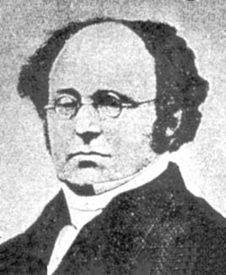
Set identities: DE Morgan's LAWS
These should look
very familiar…

Slide 42
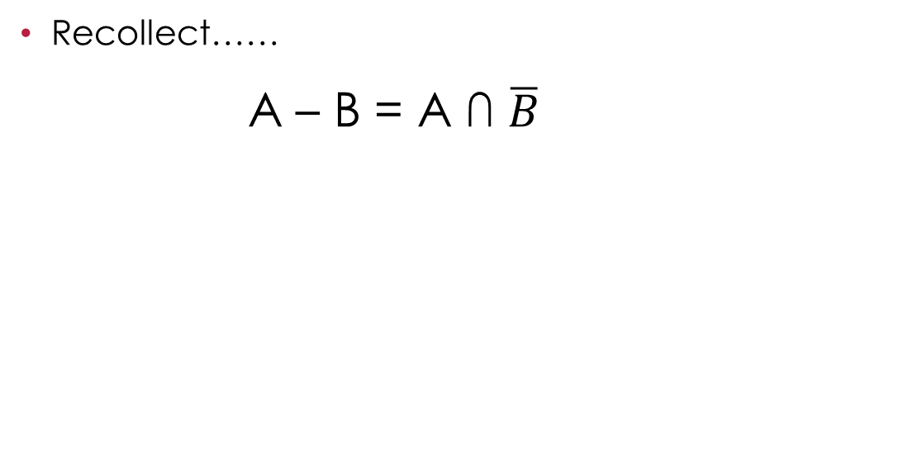
Set identities: Definition of Difference

Slide 43
How to prove a set identity
For example: A∩B=B-(B-A)
Four methods:
  Use the basic set identities
  Use Venn diagrams
  Prove each set is a subset of each other
    This is like proving that two numbers are equal by showing that each is less than or equal to the other
  Use set builder notation and logical equivalences

Slide 44
What we are going to prove…
A∩B=B-(B-A)
A
B
B-(B-A)
B-A

Slide 45

Proof by using basic set identities
Definition of difference
Definition of difference
DeMorgan’s law
Complementation law
Distributive law
Complement law
Identity law
Commutative law

Slide 46
Thank you!
By:- Eng. A.l. Jubailah begum

